Slide 1
CH 7: Supporting Materials
Brandon Straight

Slide 2
Examples, Illustrations, and Narratives
Example-
brief specific instance
Illustrations- more detailed example
Narrative- example told in a story format

Slide 3
Guidelines for using
Limit the length
Stress relevancy
Distinguish between real and hypothetical examples
Real
Hypothetical
Make sure they are relevant

Slide 4
Analogies
Analogies- are comparisons between things that may be like each other.
Literal Analogy
Compare items from same class, two cars or two cities
Figurative Analogy
Compare a car to the freedom of a bird
Guidelines
Use comparable cases
Place differences in context
Notes:
Differences in context- salary of an accountant in city versus rural when looking at national averages

Slide 5
Testimony
Testimony- is the opinions or recollections of experts
Expert testimony- they are considered an expert in their field
Eyewitness testimony- cite the testimony of someone who saw or heard an event

Slide 6
Interviews
Select the person you wish to interview
Secure an appointment
Select your topic areas
Create a cheat sheet
Establish rapport with the interviewee
Ask open-ended questions
Display effective interpersonal communication
Ask for permission to record or print the interview
Close with an expression of appreciation
Follow up with a thank-you note

Slide 7
Numerical data
Raw numbers- simply figures unmodified by any mathematical
Statistics- figures that help you communicate large data to understandable numbers
Central tendency (Mean, Median, Mode)
Measures of correlation
Measures of difference
Percentages
Guidelines
Make sure the numbers are clear
Make explicit the meaning of the numbers you’re using
Use numbers in moderation
Use only reliable and current numerical data

Slide 8
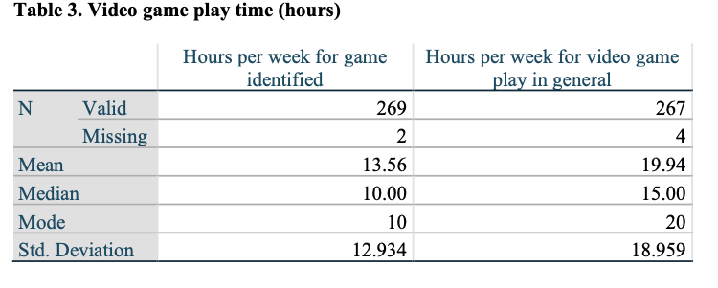
Ex. Central Tendency

Slide 9
Measure of Difference
Tells you how much scores differ from the average
Range- how far the lowest score is from the highest score
High range- large diversity
Low range- great similarity

Slide 10
Summary
How do you like to see statistics or hear about statistics?
What supporting materials do you think are the most effective or what would you use?
When is the best time to include supporting materials.

